Slide 1
Configuration Guide
(IDE – Eclipse 3.4)
2008. 12. 09
CODELABOR
Shin Sang Jae (codelabor@gmail.com)

Slide 2
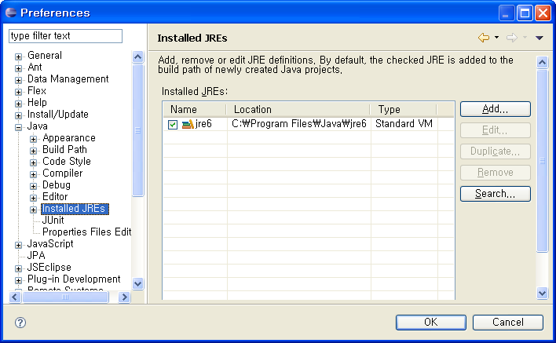
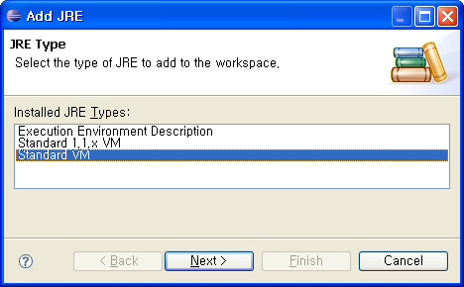
IDE
Installed JREs
Windows ＞ Preferences ＞ Java ＞ Installed JREs

Slide 3
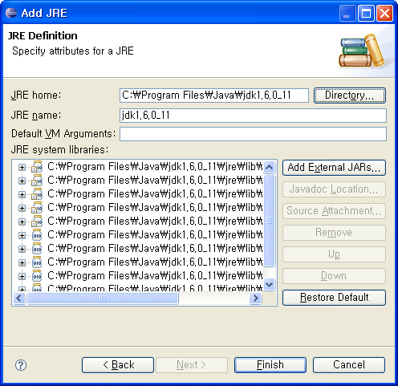
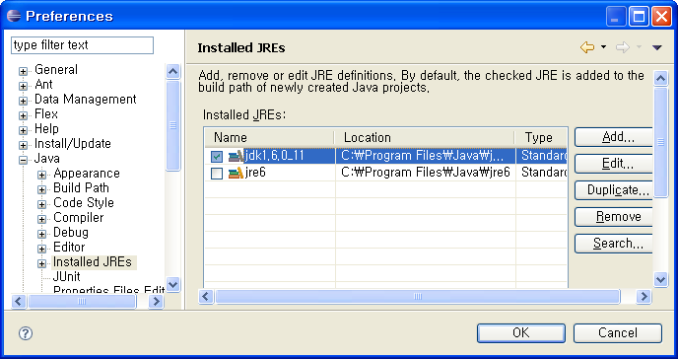
IDE
Installed JREs
Check jdk1.6.0_11

Slide 4
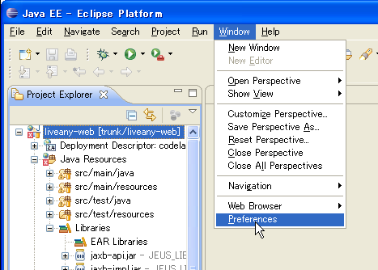
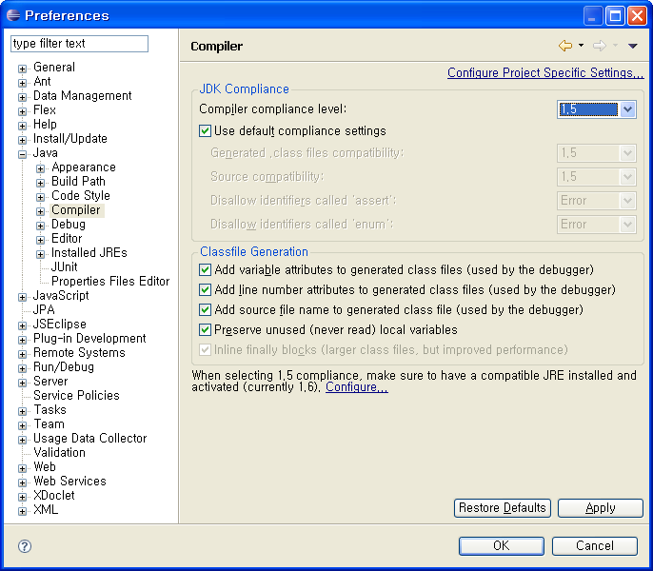
IDE
Compiler Compliance
Windows ＞ Preferences ＞ Java ＞ Compiler
Default Complicance Setting: 1.5

Slide 5
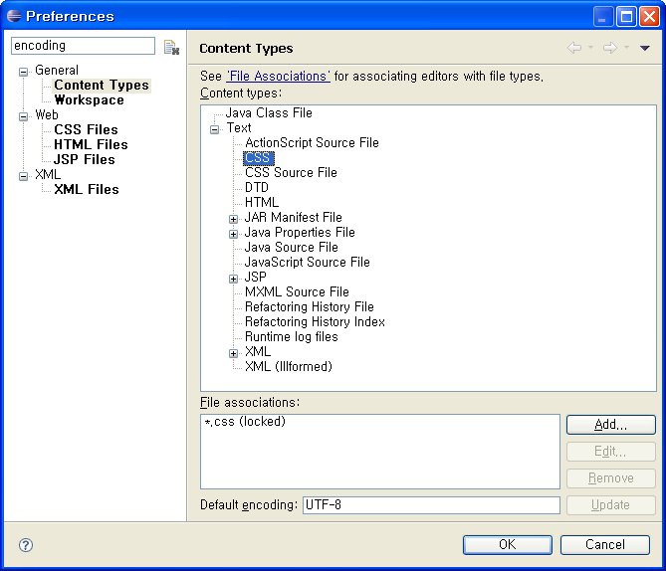
IDE
Encoding
Windows ＞ Preferences
Search Keyword: encoding
CSS: UTF-8
HTML: UTF-8
Java Properties File: ISO-8859-1
Java Source File: UTF-8
Java Script Source File: UTF-8
JSP: UTF-8

Slide 6
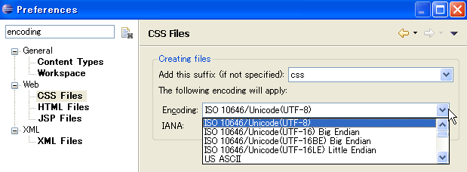
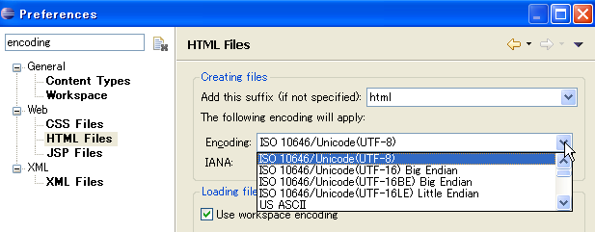
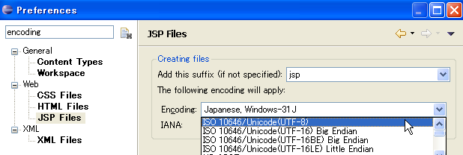
IDE
Encoding
CSS: ISO 10646/Unicode(UTF-8)
HTML: ISO 10646/Unicode(UTF-8)
JSP: ISO 10646/Unicode(UTF-8)

Slide 7
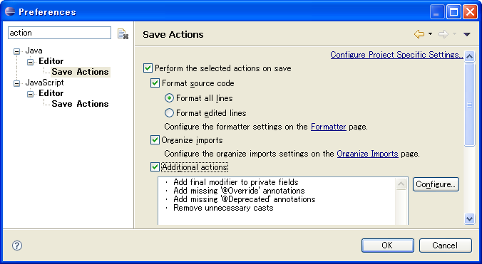
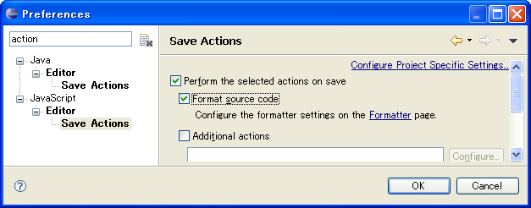
IDE
Save Action
Windows ＞ Preferences
Search Keyword: action
Format source code
Organize imports
Additional actions
Format source code

Slide 8
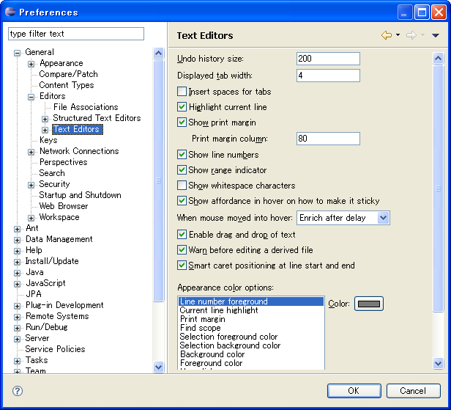
IDE
Text Editong
Windows ＞ Preferences > General > Editors > Text Editors
Show print margin
Show line numbers

Slide 9
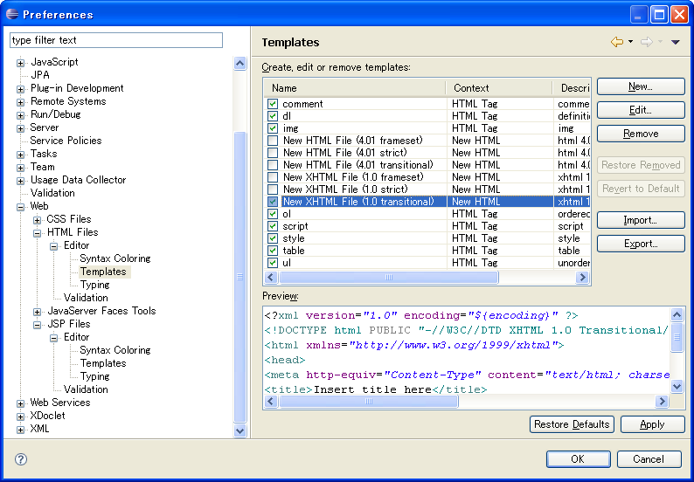
IDE
New File Template
Windows ＞ Preferences > Web > HTML Files > Editor > Template
HTML: New XHTML File (1.0 transitional)

Slide 10
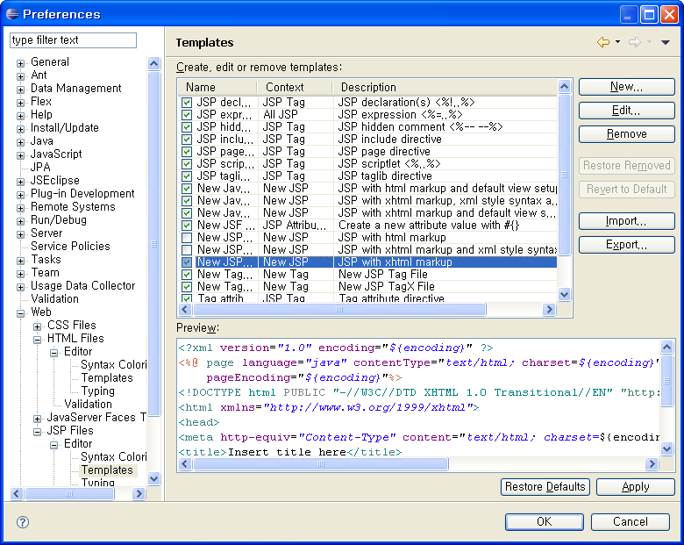
IDE
New File Template
Windows ＞ Preferences > Web > JSP Files > Editor > Template
JSP: New JSP File (xhtml)

Slide 11
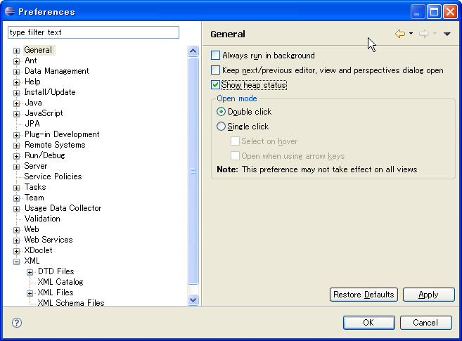

IDE
Heap Status
Windows ＞ Preferences > General
Show heap status

Slide 12
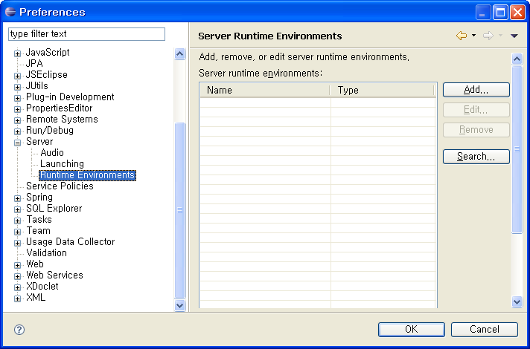
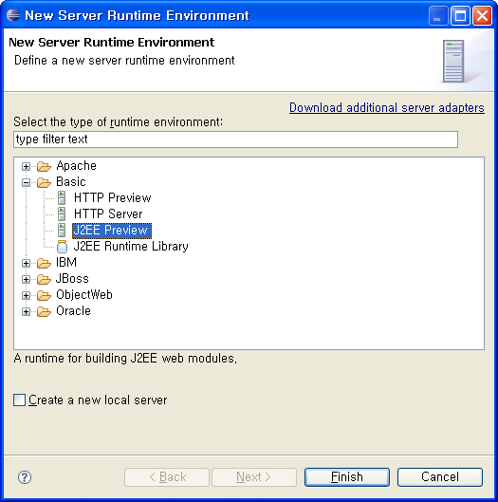
IDE
Runtime Environment
Windows ＞ Preferences > Server > Runtime Environment
Define J2EE Runtime Library: J2EE Preview

Slide 13
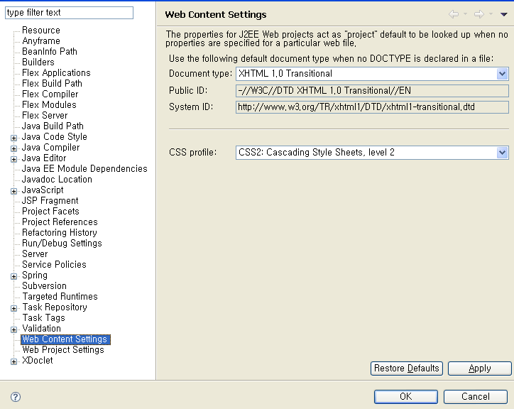
IDE
Web Content Settings
Project ＞ Preferences > Web Content Settings
Document Type: XHTML 1.0 Transitional
CSS profile: CSS2: Cascading Style Sheets, level 2

Slide 14
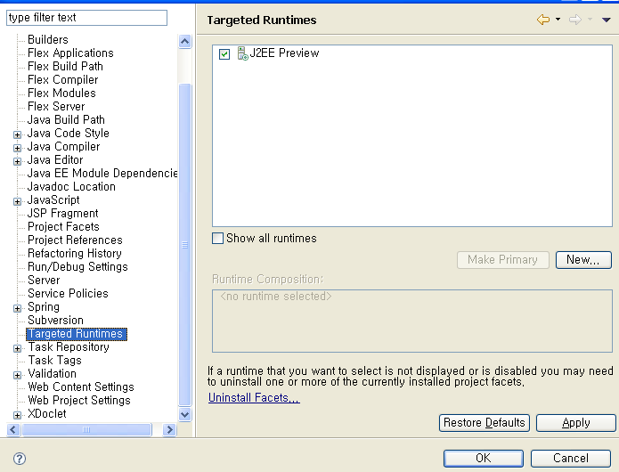
IDE
Targeted Runtimes
Project ＞ Preferences > Targeted Runtimes
J2EE Preview

